Slide 1
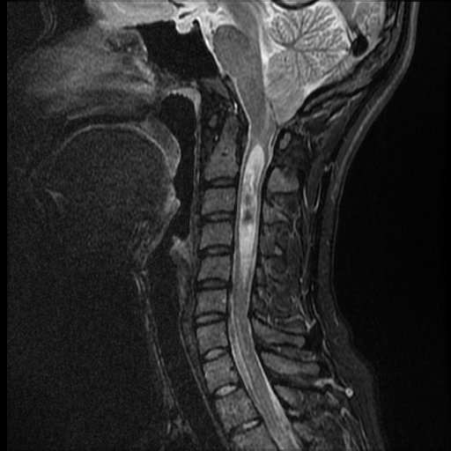
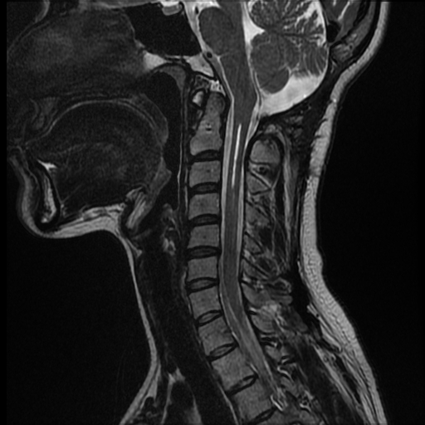
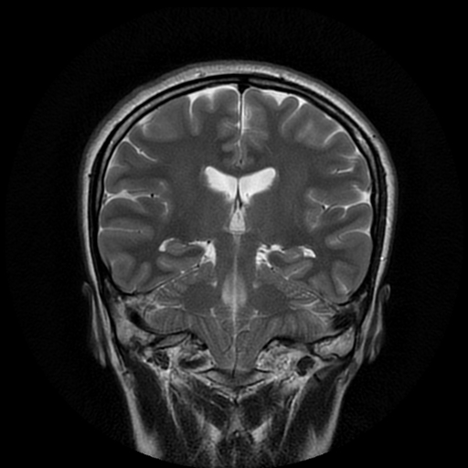
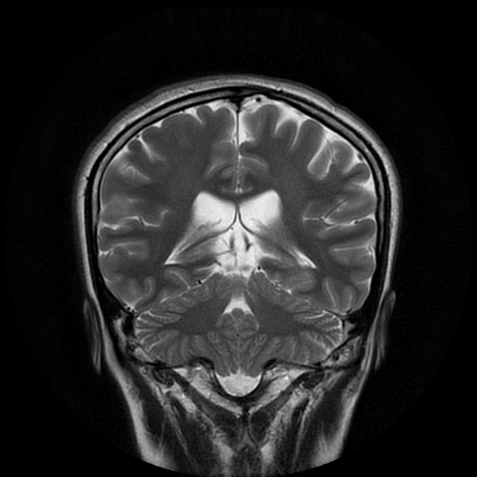
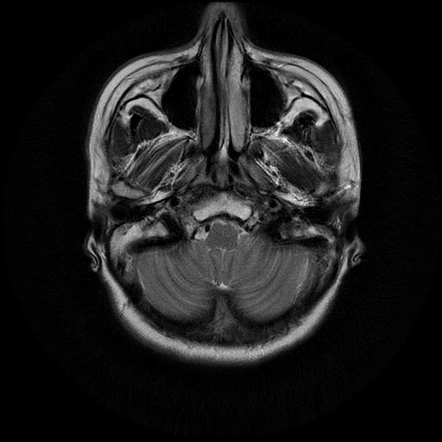
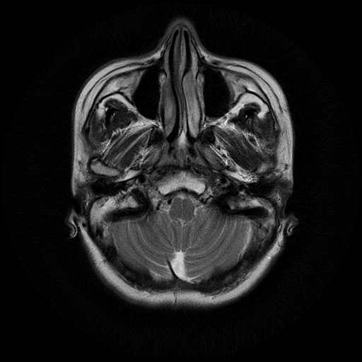
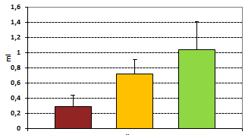
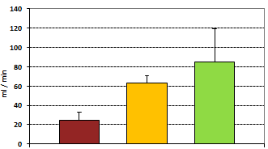
Chiari type I malformation (CM): Analysis of outcome after craniovertebral decompression with arachnoid sparing technique using Cardiac Gated Phase-Contrast MRI
A. REUTOV ¹, N. ARUTIUNOV ², V. KARNAUKHOV ²
1 Central clinical hospital with outpatient health center of the Business Administration for the President of the Russian Federation
2 Burdenko neurosurgery institute
Central clinical
hospital
Burdenko
neurosurgery institute
OBJECTIVES
The aim of this study was to determine clinical effect and CSF values before and after posterior craniovertebral decompression with arachnoid sparing technique in adult CM patients by means of phase-contrast MRI data.
CSF-FLOW VALUES AT С2-С3 LEVEL IN HEALTHY VOLUNTEERS & PATIENTS WITH SYMPTOMATIC CM I PRE-OP
CLINICAL RESPONSE (6 MONTH POST OP MRI)
MATERIALS AND METHODS
To determine the normal values of CSF flow at C2-C3 level 16 healthy subjects underwent phase-contrast MRI (♂ - 8, ♀ - 8, age 22-49 y).
Same study performed in main group of symptomatic patients pre-op. Postoperative results were analyzed by means of control study six month post-op and compared with clinical outcome.
CSF FLOW PATTERNS | VOLUNTEERS (n=16) | CM I PRE-OP (n=39) | p
Volumetric flow (ml) | 1.04±0.37 | 0.29±0.15 | <0.05
Linear average velocities amplitude (cm/s) | 2.25±0.60 | 0.73±0.21 | <0.05
Linear maximum velocities amplitude (cm/s) | 7.2±0.68 | 5.1±0.73 | <0.05
Volumetric velocities amplitude (ml/min) | 341±106.04 | 90.8±23.77 | <0.05
Mean average linear velocity (cm/s) | 0.68±0.21 | 0.2±0.08 | <0.05
Mean maximal linear velocity (cm/s) | 2.45±0.52 | 2.02±0.21 | <0.05
Mean volumetric (ml/min) | 84.56±34.52 | 24.5±8.13 | <0.05
Intra-op view
Regression of syrinx 68%
Ascending and “rounding” of tonsils
100 CM consecutive patients were enrolled in the study. In 86 patients the uniform posterior craniovertebral decompression (CVD) consisted of a suboccipital craniectomy, a C1 laminectomy and duroplasty with arachnoid sparing was used. The rest of patients underwent various surgical procedures like ETV, VPS or combination with CVD. These patients were excluded from analysis.
Positive MRI results 92%
After surgery a good clinical outcome was achieved with minor complications
Data analyze shows significantly decreased patterns and abnormal CSF dynamics in the upper cervical segment
Cisterna magna “de novo”
Improvement of pre-op symptoms | %
Pain (H/A, neck) | 90
Gait disturbance | 67
Bulbar palsy | 40
Cranial nerves palsy (III-VII) | 43
Weakness (1 or more limbs) | 60
Numbness (1 or more limbs) | 38
Karnofsky index
pre and post (р < 0,005)
NEUROIMAGING DATA AND MRI CRITERIA
CSF-FLOW VALUES AT С2-С3 LEVEL IN PATIENTS WITH SYMPTOMATIC CM I POST-OP
All MRI examinations were performed using Signa 1.5 Tesla scanners with standard sequences (sagittal T1WI, axial T1WI, axial T2WI). Syringomyelia was present in 45%, Hydrocephalus in 9%. Tonsillar ectopia ranged 4 – 32 мм (~11 мм) and did not correlate with symptomatology!
CSF flow patterns were evaluated in a region of interest - ventral and dorsal subarachnoid spaces at C2-C3 level. CSF flow waveforms were analyzed by measuring CSF linear average and maximum velocities amplitude, Volumetric velocities amplitude of cranial and caudal-directed flows. The main accent was given to a volumetric flow – a total amount of CSF passed via the zone of interest during a single cardiac cycle. Data was analyzed by software package “Flow Analysis”.
Oblique sulci
Sloped tentorium
Short clivus
McRay line
After performing craniovertebral decompression consisted of a suboccipital craniectomy, a C1 laminectomy and autologous duraplasty with arachnoid sparing we observed significant improvement of main CSF-flow patterns in the region of interest.
CSF FLOW PATTERNS | VOLUNTEERS (n=16) | CM I POST-OP (n=39) | p
Volumetric flow (ml) | 1.04±0.37 | 0.72±0.19 | <0.05
Linear average velocities amplitude (cm/s) | 2.25±0.60 | 1.8±0.70 | >0.05
Linear maximum velocities amplitude (cm/s) | 7.2±0.68 | 8.72±5.06 | <0.05
Volumetric velocities amplitude (ml/min) | 341±106.04 | 226.45±65.07 | <0.05
Mean average linear velocity (cm/s) | 0.68±0.21 | 0.51±0.13 | >0.05
Mean maximal linear velocity (cm/s) | 2.45±0.52 | 3.39±2.13 | >0.05
Mean volumetric (ml/min) | 84.56±34.52 | 63.28±6.98 | <0.05
syrinx
N.B! CSF-related complications (CSF leak, pseudomeningocele, meningitis) were observed in only in 9 cases,
when arachnoidea was unintentionally perforated!
Peg – like tonsils
RESULTS AND CONCLUSION
After surgery a good clinical outcome was achieved. Main CSF-flow values improved. We observed statistically significant correlation between post-surgical improvement (80%) and MRI data (92%).
Craniovertebral decompression with autologous duroplasty without subarachnoidal manipulations is an appropriate treatment modality for symptomatic CM with minor possible complications. Cardiac gated phase-contrast MRI is a valuable method in determining the CSF disturbances in patients with CM which strongly correlate with clinical outcome.
Results of the study confirm current trend for the use of less aggressive surgeries in majority of cases in symptomatic CM and were recommended as “Clinical guidelines for the surgical treatment of Chiari malformation in adults” in Russian Federation in 2015.
Pathophysiology of CM more strongly correlate with severity of CSF flow disorder rather then with degree of tonsillar descend!
The main attention was paid to changes in volumetric flow – the total amount of CSF passing through the region of interest during a single cardiac cycle and to mean volumetric velocity.
Narrowed cisterna magna
SEARCH FOR
Т1WI | Т2WI
Caudal descend of Pointed «peg-like» tonsils ≥ 5мм | Oblique tonsillar folia («Sergeant chevron»)
«Tight» and crowding of posterior fossa with compressed cisterns | Upper cervical cord edema
Elongation and displacement of IV ventricle | Syringomyelia
 | Superiorly oriented straight sinus and low transverse sinus
Low nucleus gracilis
Volumetric flow
Mean volumetric velocity
CM pre-op
CONTACT INFORMATION
Contact: Dr. Andrey Reutov. FSBI “Central clinical hospital with outpatient health center” of the Business Administration for the President of the Russian Federation. 121359, Marshala Timoshenko str. 15, Moscow. email: reutov@centerneuro.ru, website: centerneuro.ru
CM post-op
Volunteers

